Slide 1
Building Flexible Perspective Taking in the therapy room: distinguishing between self and experiences
Mary Sawyer: Private Practice Sydney Australia
Martin Brock: Senior Lecturer University of Derby UK

Slide 2
At the completion of this workshop you will be able to:
Explore the process of self and their function within the therapeutic context
Describe the processes of self as content, self as process and self as context
Practice building a flexible sense of self in your clients by evoking observation of experiences and their impact on client behaviours

Slide 3
The Holy Trinity of the Three Selves
1. Self as Context/Self as Perspective
2. Self as Process
3. Self as Content/Self as story

Slide 4
1. Self as Context/Self as Perspective
Cannot observe this perspective in itself
Our very own perspective is void of content
Point from which we observe, act, and live our lives
Context within, or perspective from which we experience what we experience

Slide 5
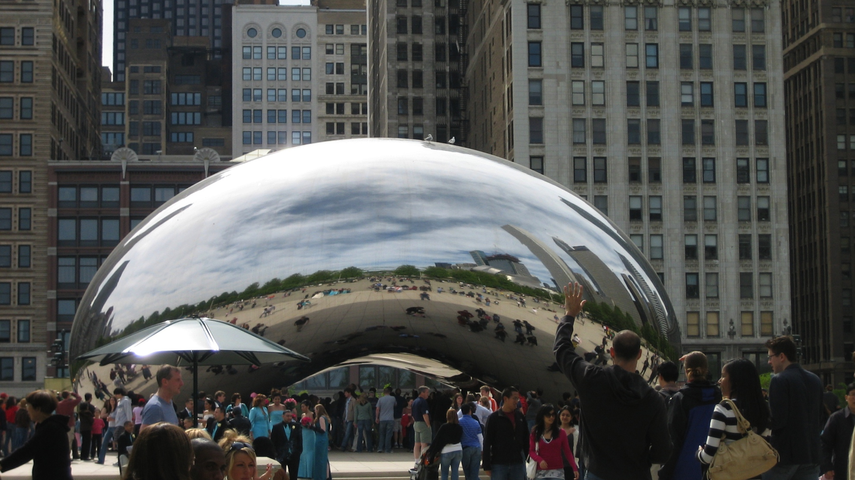
Experiencing what we are experiencing

Slide 6
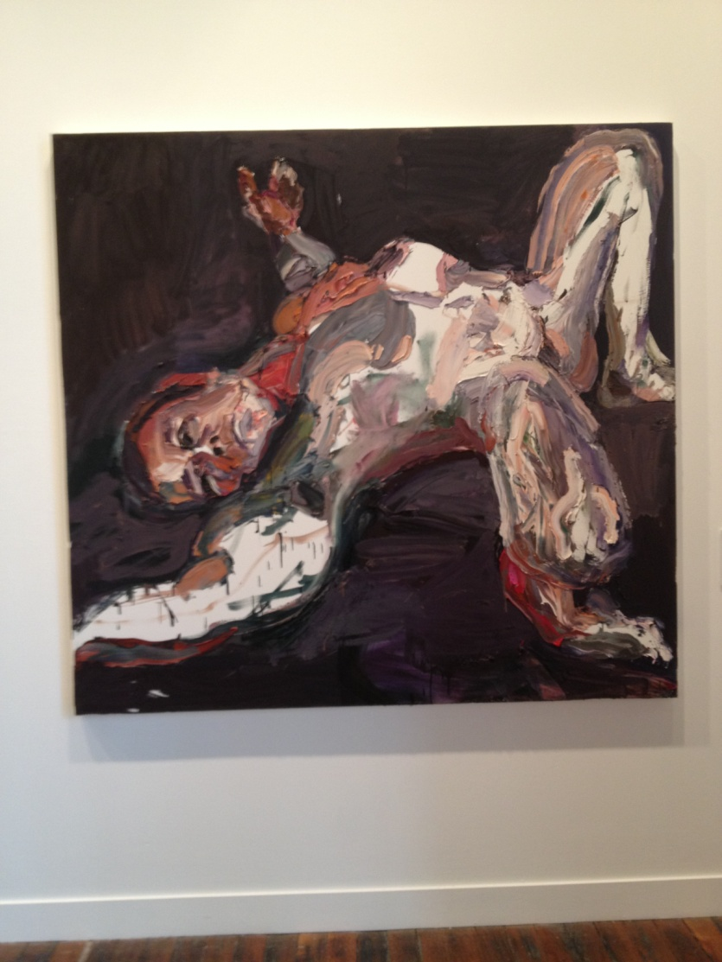
That was me “there then”
An Australian soldier during Afghanistan
Courtesy of the artist
Ben Quilty

Slide 7
Concept of ‘Self’ Goes Beyond This
We do not experience ourselves as void of content
We need to do more reasoning
RFT describes two more aspects of ‘Self’

Slide 8
2. Self as Process
How I describe what I do right now: “I here now notice that I see, touch, smell, think, feel and do” here-now
Ongoing, experiencing and describing your thoughts, a fluid process, must be perceived as here- now
Simply the way we learn to talk about our behaviour, feelings, sensations and facilitates communication

Slide 9
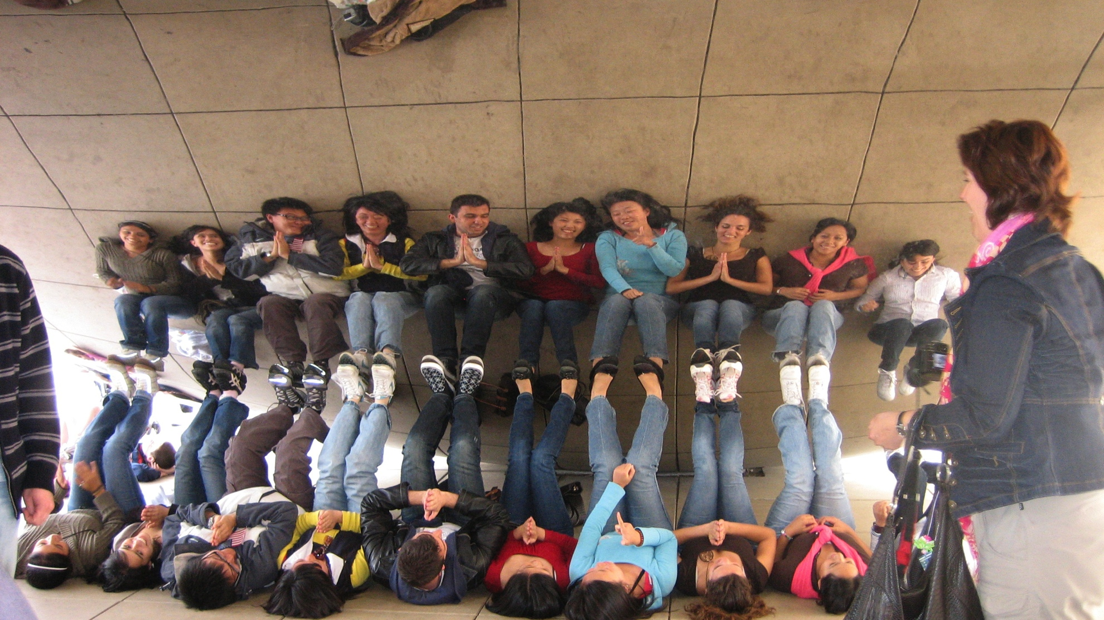
I Here Now notice what I see, touch, smell, think, feel & do

Slide 10
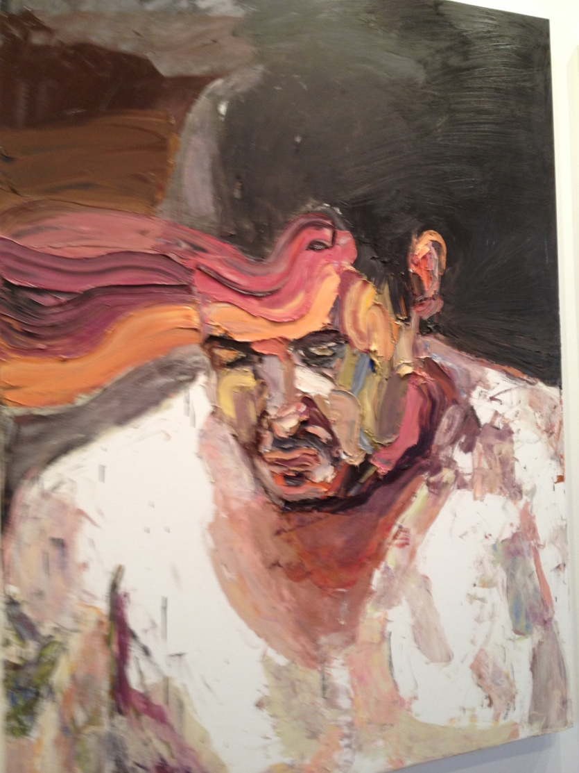
What am I feeling, thinking, sensing, remembering here now?
An Australian Soldier
after Afghanistan
Courtesy of the artist
Ben Quilty

Slide 11
3. Self as Content/Self as story
Self as Content: how I describe myself in words, here now. “I am” is set up via verbal processes, can link us into a particular identity and can limit our lives.
Descriptions, evaluations, relations between who you are and what you think
An extreme simplification of all that the self is
Entanglement in content can become rigid and conceptualised

Slide 12
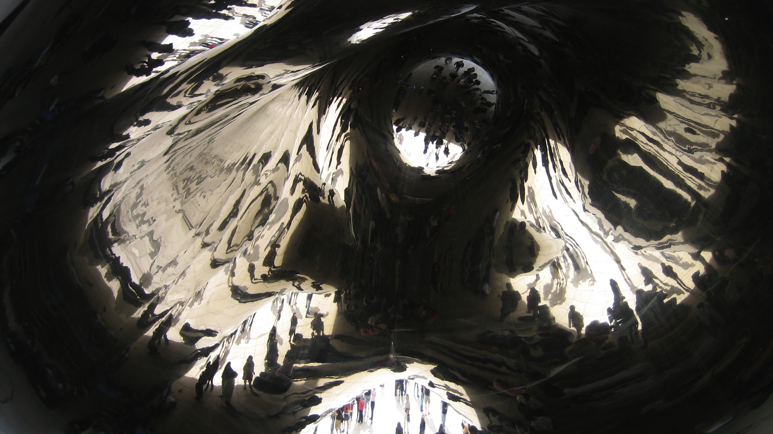
Describing myself in words here now: a mixture of content

Slide 13
Self as Content
I’m not your ordinary girl
I’m a Bad Parent
I’m depressed all the time
I’m a rock star
I’m crazy
I’m damaged goods

Slide 14
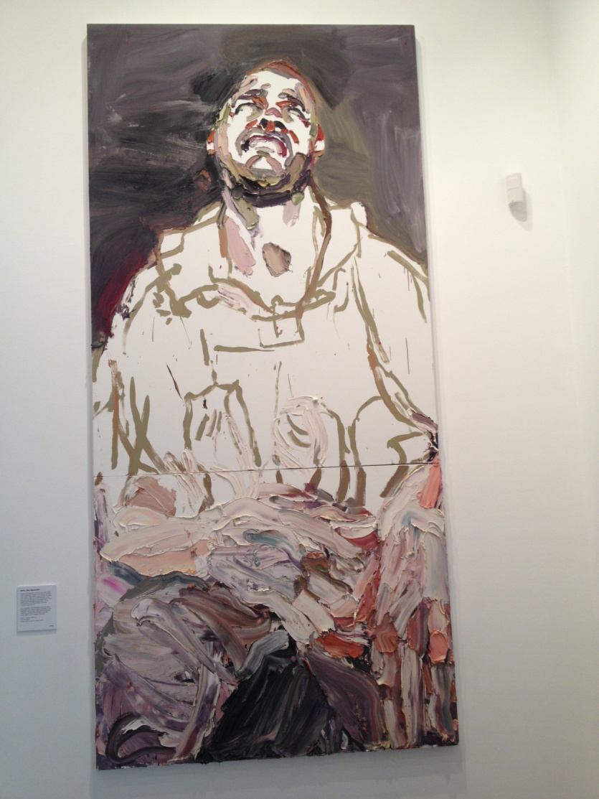
“I am………….”
An Australian soldier after Afghanistan
Courtesy of the artist
Ben Quilty

